Slide 1
Enterprise Systems Development – Sprint 1
Group Members:
Austin Harper, Conran Pearce, Harrison Bennion, Morgan Welch and Sam Kirk
https://github.com/m3-welch/ESD-Group-3-CW1

Slide 2
Progress Summary
Initial task planning and interaction between group members.
Scheduling of tasks was carried out through finding out strengths of individuals.
Created a database and Java classes that are connected, allowing querying to be carried out.
Basic front-end created with the ability to log in a user.
Determining user permission by establishing interaction between the front-end log in page and the database.

Slide 3
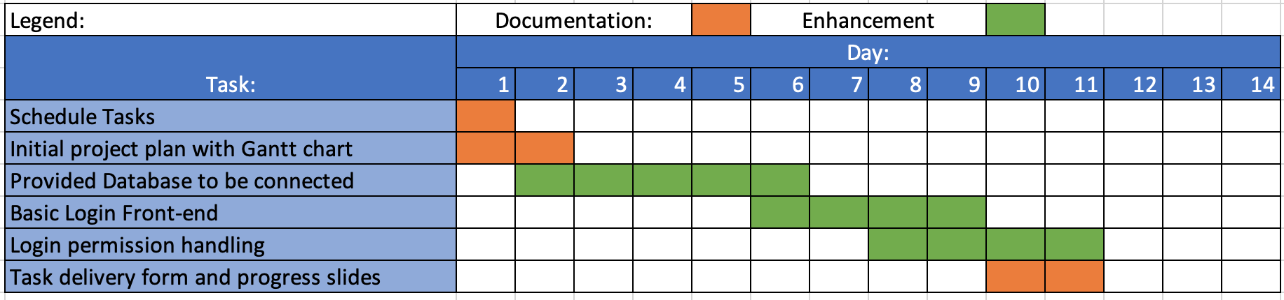
Project Plan (Gantt Chart)

Slide 4

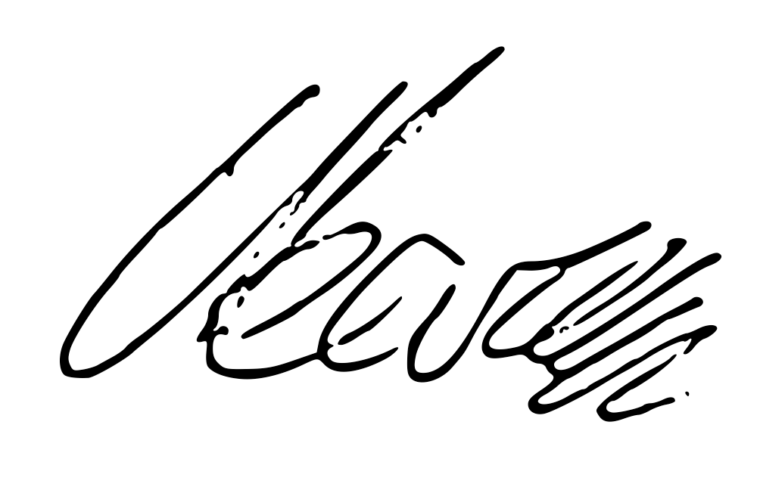

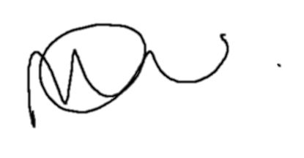

Task Delivery Form
 | Tasks
Group Members | T₁ | T₂ | T₃ | T₄ | T₅ | T₆ | Signature
Austin Harper | ✓ |  |  | ✓
Conran Pearce | ✓ |  |  |  |  | ✓
Harrison Bennion | ✓ | ✓
Morgan Welch | ✓ |  |  |  | ✓
Sam Kirk | ✓ |  | ✓
Status of Completion (%)
List of Task: T1. Schedule Tasks T2. Initial project plan with Gantt chart T3. Basic Login Front-end T4. Login permission handling T5. Provided database to be connected T6. Burn down chart

Slide 5
Burn Down Chart

